Slide 1
Data Structures
Lecture-16
Binary Trees
Binary Search Trees
Kartik Mathur

Slide 2
Binary Trees
Diameter and height in O(N).
Mirror of a Tree.
Input Tree Levelwise.
Make a tree using Inorder and PreOrder
Notes:
Talk about circular linked list

Slide 3
Binary Search Trees
Notes:
Make them create one file from next time

Slide 4
BST Properties
Every Node in left subtree has value less than or equal to root
Every Node in right subtree has value greater than or equal to root
Notes:
Talk about circular linked list

Slide 5
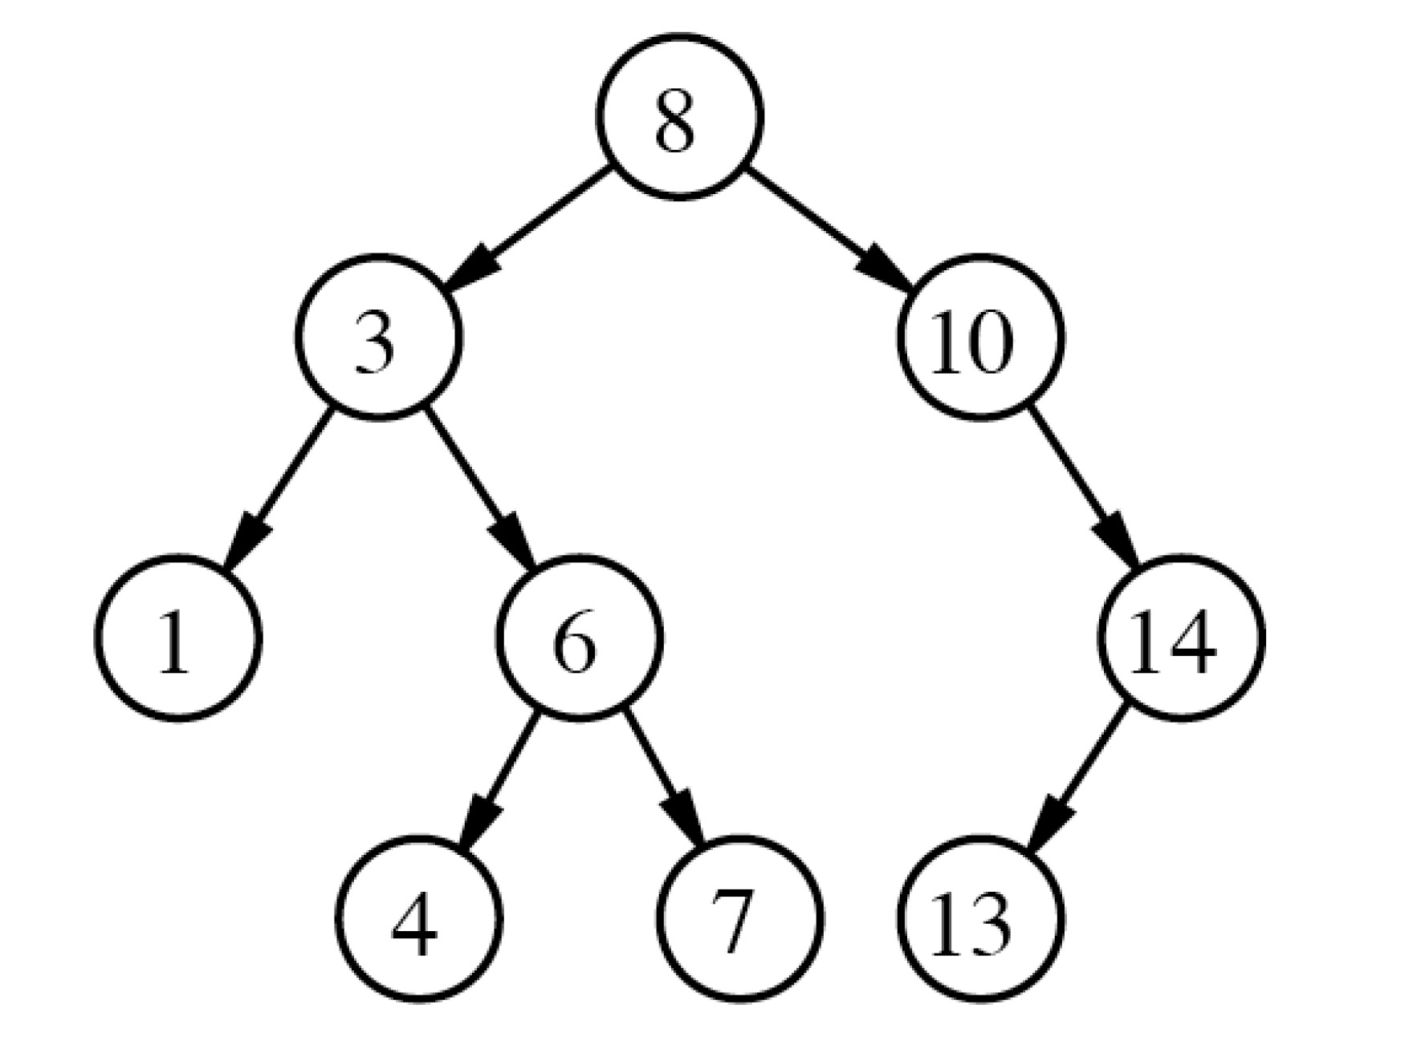
Binary Search trees
Notes:
Talk about circular linked list

Slide 6
Binary Search Trees
class BinarySearchTree{
// accessor methods
int size();
bool isEmpty(); bool findElement(int element);
// update methods void addElement(int element); void removeElement(int element) throws BSTEmptyException;
}
Notes:
Talk about circular linked list

Slide 7
Lets discuss few problems
Print BST elements in range K1 and K2
Search & Adding element in BST
Notes:
Talk about circular linked list

Slide 8
Your Turn
Convert a BST into sorted Linked List
Given a binary tree check if its BST
Check if a Binary Tree is Balanced
Notes:
Talk about circular linked list

Slide 9
Build a BST using a sorted array
Notes:
Make them create one file from next time

Slide 10
Deletion in BST?
Notes:
Talk about circular linked list

Slide 11
Right View of BT?
Notes:
Talk about circular linked list

Slide 12
Maximum Path Sum Any to Any Node
Notes:
Make them create one file from next time

Slide 13
Thank You!
Kartik Mathur

